Slide 1
Chapter 2: PROBABILITY
Chapter outline
2.1 Sample Spaces and Events
2.2 Interpretations of Probability
2.3 Addition Rules
2.4 Conditional Probability
2.5 Multiplication Rules
2.6 Independence
2.7 Multiplication and Total Probability Rules
2.8 Bayes’ Theorem

Slide 2
Learning Objectives
After careful study of this chapter, you should be able to do the following:
1. Understand and describe sample spaces and events for random experiments with graphs, tables, lists,or tree diagrams.
2. Interpret probabilities and use the probabilities of outcomes to calculate probabilities of events indiscrete sample spaces.
3. Use permuations and combinations to count the number of outcomes in both an event and the sample space.
4. Calculate the probabilities of joint events such as unions and intersections from the probabilities of individual events.
5. Interpret and calculate conditional probabilities of events.
6. Determine the independence of events and use independence to calculate probabilities.
7. Use Bayes’ theorem to calculate conditional probabilities.

Slide 3
Key words
1. Sample spaces
2. Events
3. Random experiments
4. Outcomes
5. Permutation
6. Arrangements
7. Combinations
8. Mutually exclusive

Slide 4
2.1 Sample Spaces and Events
2.1.1 Random Experiments
Definition: An experiment that can result in different outcomes, even though it is repeated in the same manner every time, is called a random experiment.
2.1.2 Sample Spaces
Definition: The set of all possible outcomes of a random experiment is called the sample space of the experiment. The sample space is denoted as S.

Slide 5
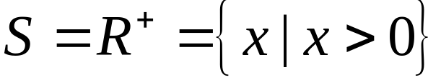
2.1 Sample Spaces and Events
2.1.2 Sample Spaces
Example 1
Consider an experiment that selects a cell phone camera and records the recycle time of a flash (the time taken to ready the camera for another flash). The possible values for this time depend on the resolution of the timer and on the minimum and maximum recycle times. However, because the time is positive it is convenient to define the sample space as simply the positive real line

Slide 6
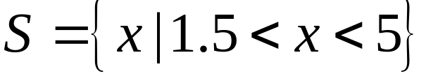
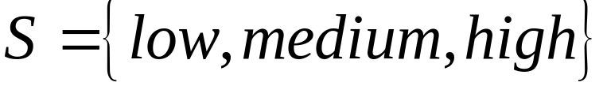
2.1 Sample Spaces and Events
2.1.2 Sample Spaces
Example 1(cont)
If it is known that all recycle times are between 1.5 and 5 seconds, the sample space can be
If the objective of the analysis is to consider only whether the recycle time is low, medium, or high, the sample space can be taken to be the set of three outcomes S

Slide 7
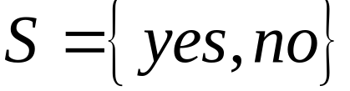
2.1 Sample Spaces and Events
2.1.2 Sample Spaces
Example 1 (cont)
If the objective is only to evaluate whether or not a particular camera conforms to a minimum recycle time specifi cation,the sample space can be simplified to a set of two outcomes
that indicates whether or not the camera conforms.

Slide 8
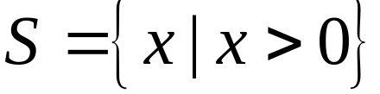
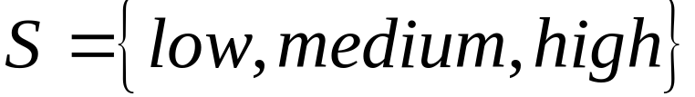
2.1 Sample Spaces and Events
2.1.2 Sample Spaces
Two types of sample spaces
A sample space is discrete if it consists of a fi nite or countable infinite set of outcomes.
A sample space is continuous if it contains an interval (either fi nite or infi nite) ofreal numbers.
Example 2: In example 1
is an example of a continuous sample space.
is a discrete sample space

Slide 9
2.1 Sample Spaces and Events
Tree Diagrams
Sample spaces can also be described graphically with tree diagrams.
  When a sample space can be constructed in several steps or stages, we can represent each of the n₁ ways of completing the first step as a branch of a tree.
  Each of the ways of completing the second step can be represented as n₂ branches starting from the ends of the original branches, and so forth.
Notes:
Stage: giai đoạn

Slide 10
2.1 Sample Spaces and Events
2.1.2 Sample Spaces
Example 2
Each message in a digital communication system is classified as to whether it is received within the time specified by the system design. If three messages are classified, use a tree diagram to represent the sample space of possible outcomes.
Each message can be received either on time or late. The possible results for three messages can be displayed by eight branches in the tree diagram shown in Fig 1.

Slide 11
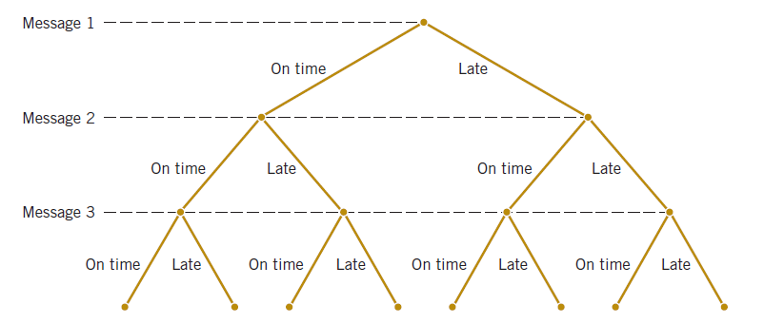
2.1.Sample Spaces and Events
2.1.2 Sample Spaces
Example 2 (cont)
Fig 1: Tree diagram for three messages.

Slide 12
2.1.Sample Spaces and Events
2.1.2 Sample Spaces
Example 3
An automobile manufacturer provides vehicles equipped with selected options. Each vehicle is ordered
With or without an automatic transmission
With or without a sunroof
With one of three choices of a stereo system
With one of four exterior colors

Slide 13
2.1 Sample Spaces and Events
2.1.2 Sample Spaces
Example 3 (cont)
If the sample space consists of the set of all possible vehicle types, what is the number of outcomes in the sample space?
The sample space contains 48 outcomes. The tree diagram for the different types of vehicles is displayed in Fig 2

Slide 14
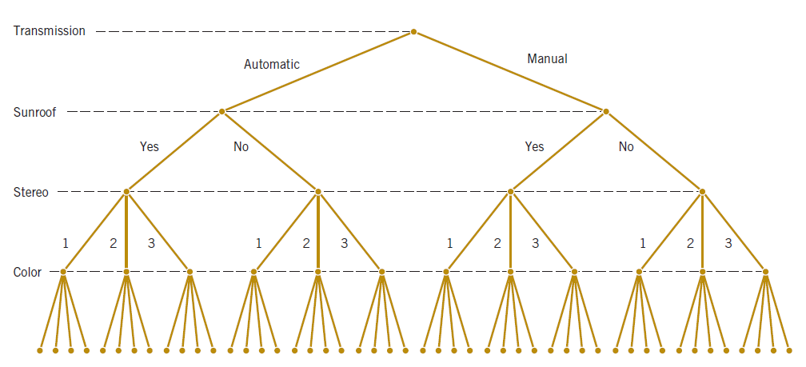
2.1 Sample Spaces and Events
2.1.2 Sample Spaces
Example 3 (cont)
Fig 2: Tree diagram for different types of vehicles with 48 outcomes in the sample space.

Slide 15
2.1 Sample Spaces and Events
2.1.3 Events
Definition
An event is a subset of the sample space of a random experiment.

Slide 16


2.1 Sample Spaces and Events
2.1.3 Events
Basic Set Operations
The union of two events is the event that consists of all outcomes that are contained in either of the two events. We denote the union as
The intersection of two events is the event that consists of all outcomes that are contained
in both of the two events. We denote the intersection as

Slide 17



2.1 Sample Spaces and Events
2.1.3 Events
Basic Set Operations
The complement of an event in a sample space is the set of outcomes in the sample space that are not in the event. We denote the complement of the event as ( or ).

Slide 18
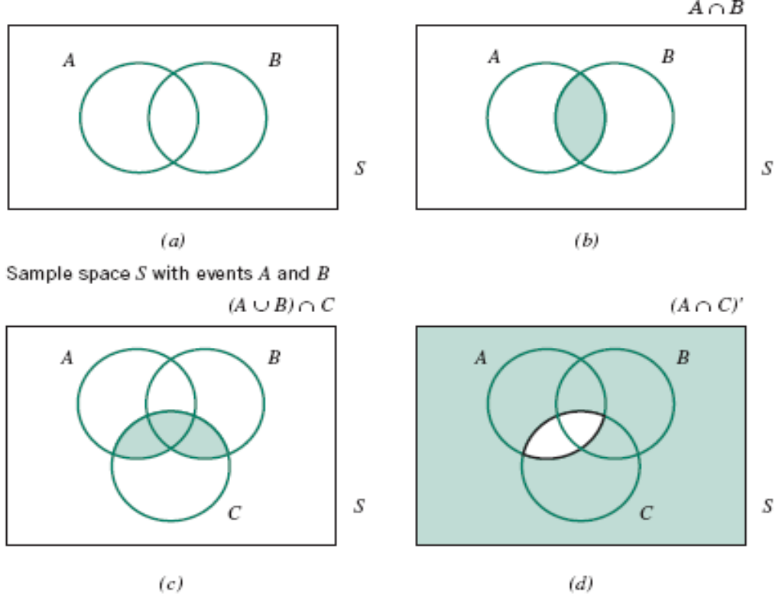
2.1 Sample Spaces and Events
Venn Diagrams
Fig 3: Venn diagrams.

Slide 19





2.1 Sample Spaces and Events
2.1.4 Counting Techniques
Multiplication
If an operation can be described as a sequence of steps, and
If the number of ways of completing step 1 is , and
If the number of ways of completing step 2 is for each way of completing step 1, and
If the number of ways of completing step 3 is for each way of completing step 2, and so forth
The total number of ways of completing the operation is

Slide 20

2.1 Sample Spaces and Events
2.1.4 Counting Techniques
Example
In the design of a casing for a gear housing, we can ues four different types of fasteners, three different bolt lengths and three different bolt locations.
From the multiplication rule,
different design are possible

Slide 21


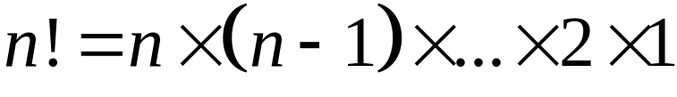
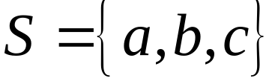


2.1 Sample Spaces and Events
2.1.4 Counting Techniques
Permutation
A permutation of the elements is an ordered
sequence of the elements
The number of permutation of different elements
is where
Example
Let then
are all of the permutations of the elements of

Slide 22


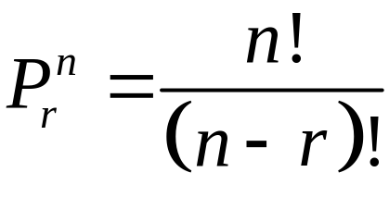
2.1 Sample Spaces and Events
2.1.4 Counting Techniques
Permutation of Subsets
The number of permutations of subsets of elements
selected from a set of different elements is
Example
A printed circuit board has eight different locations in which a component can be placed. If four different components are to be placed on the board, how many different designs are possible?

Slide 23
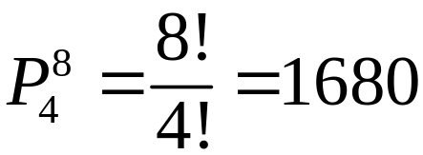
2.1 Sample Spaces and Events
Solution:
Each design consists of selecting a location from the eight
locations for the first component, a location from the
remaining seven for the second component, a location from
the remaining five for the third component, and a location
from the remaining five for the fourth component.
Therefore,
different designs are possible.

Slide 24





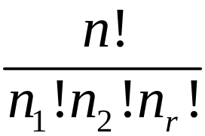
2.1 Sample Spaces and Events
2.1.4 Counting Techniques
Permutation of Similar Objects
The number of permutations of
objects of which are of one types, are of a second
type ,…., and are of an type is

Slide 25
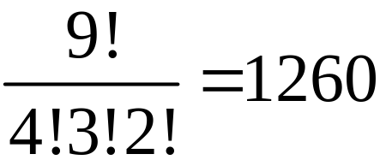
2.1 Sample Spaces and Events
2.1.4 Counting Techniques
Permutation of Similar Objects
Example:
A part is labeled by printing with four thick lines, three
medium lines, and two thin lines. If each ordering of the
nine lines represents a different label, how many different
labels can be generated by using this sheme ?
Solution:
The number of possible part label is

Slide 26


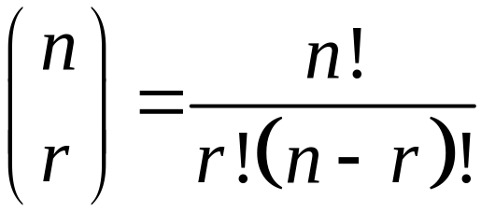
2.1 Sample Spaces and Events
2.1.4 Counting Techniques
Combination
The number of combinations, subsets of size that can be selected from a set of elements ( order is not important), is denoted as or , and

Slide 27
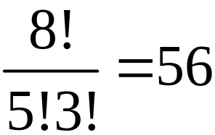
2.1 Sample Spaces and Events
2.1.4 Counting Techniques
Combination
Example 1:
A printed circuit board has eight different locations in
which a component can be placed. If five identical
components are to be placed on the board. How many
different designs are possible ?
Solution: Each design is a subset of the eight locations
that are to contain the components, so the number of
possible designs is .

Slide 28
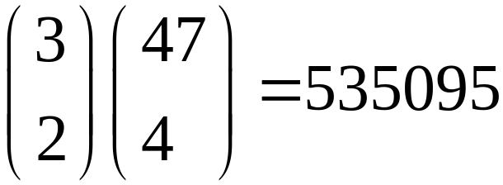
2.1 Sample Spaces and Events
2.1.4 Counting Techniques
Combination
Example 2: A bin of 50 manufactured parts contains three defective parts and 47 nondefective parts. A sample of six parts is selected from the 50 parts. Selected parts are not replaced. How many different samples are there of six that contain exactly two defective parts ?
Solution:
From the multiplication rule, the number of subsets of
size six that contain exactly two defective items is

Slide 29
2.2 Interpretations of Probability
Equally Likely Outcomes
Whenever a sample space consists of N possible
outcomes that are equally likely, the probability of each
outcome is 1/N.
For a discrete sample space, the probability of an event
E, denoted as P(E), equals the sum of the probabilities of
the outcomes in E.

Slide 30
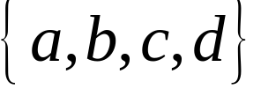

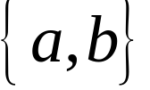

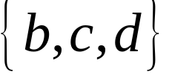





2.2 Interpretations of Probability
Example
A random experiment ca result in one of the outcomes
with probabilities 0.1,0.3,0.5 and 0.1, respectively.
Let denote the event , the event , and the
event . Find:
a/ b/
c/

Slide 31
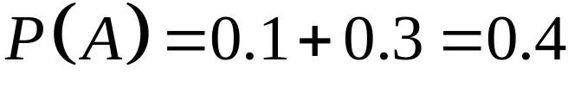
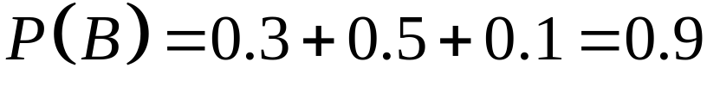
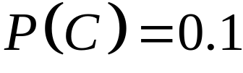
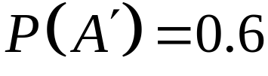
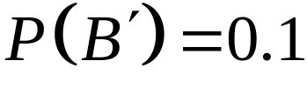
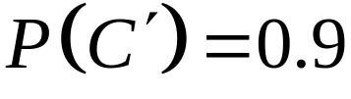

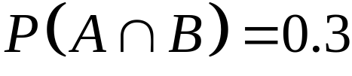


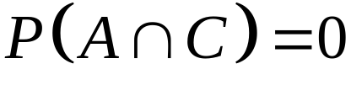
2.2 Interpretations of Probability
Solution:
a/
b/ Also, , and .
c/ Furthermore, because , . Because ,
Because is null set,

Slide 32
2.2 Interpretations of Probability
Solution:
a/
b/ Also, , and .
c/ Furthermore, because , . Because ,
Because is null set,

Slide 33


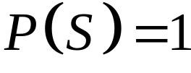
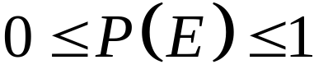



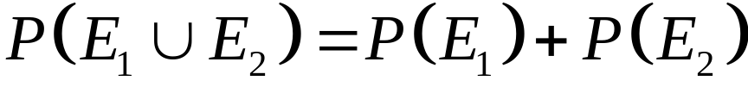
2.2 Interpretations of Probability
2.2.2 Axioms of Probability
Probability is a number that is assigned to each member of
a collection of events from a random experiment that
satisfies the following properties:
If is the sample space and is any event in a random
experiment,
a/ b/
c/ For two events and with

Slide 34
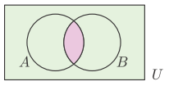
2.3 Addition Rules
Probability of a Union

Slide 35
2.3 Addition Rules
Example 1
The class has 28 students. Of these, 12 students prefer to study English, 16 students prefer to study Japanese and 8 students prefer to learn both these subjects. A student selected at random.
Find the probability to select the students prefer to learn Japanese or English ?

Slide 36
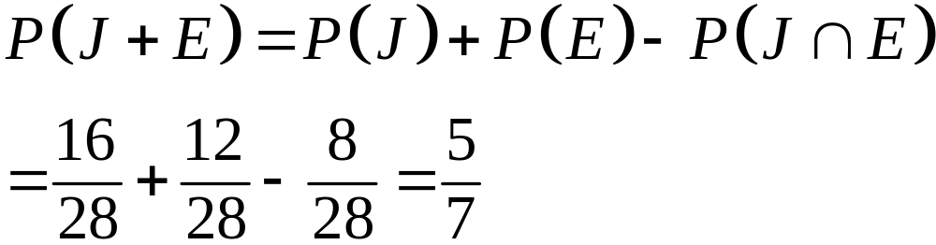
2.3 Addition Rules
Example 1
The class has 28 students. Of these, 12 students prefer to study English, 16 students prefer to study Japanese and 8 students prefer to learn both these subjects. A student selected at random.
Find the probability to select the students prefer to learn Japanese or English ?

Slide 37
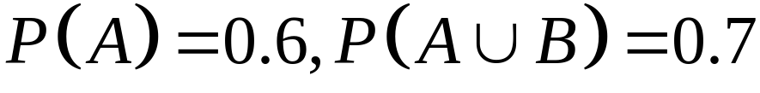
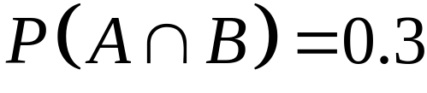

Example 2
If and
Find .

Slide 38






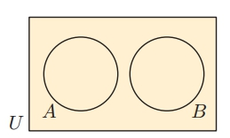
2.3 Addition Rules
Definition
Two events, denoted and such that
are said be mutually exclusive.
Theorem
If and are mutually exclusive events,

Slide 39


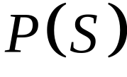
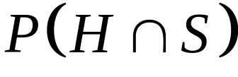

2.3 Addition Rules
Example 1: A chocolate is randomly selected from a box which contains 6 chocolates with hard centres and 12 chocolates with soft centres.
Let be the event that a randomly selected chocolate
from the box has a hard centre, and be the event
that a randomly selected chocolate from the box has a
soft centre.
a/ Are the events and mutually exclusive ?
b/ Find
i/ ii/
iii/ iv/

Slide 40

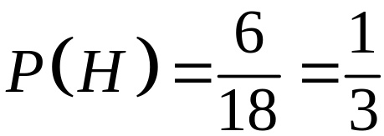
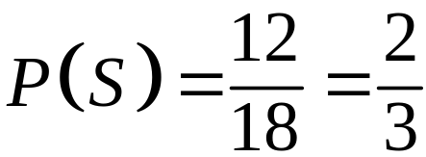
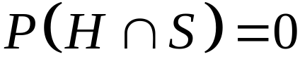
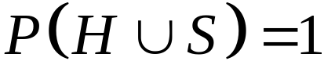
Solution:
a/ Chocolates cannot have both a hard and a soft centre
and are mutually exclusive.
b/ i/ ii/
iii/
{ a chocolate cannot have a have and a soft centre}
iv/
{ a chocolate must have a have or a soft centre}

Slide 41


2.3 Addition Rules
Three or more events
For a collection events, is said to be
mutually exclusive if for all pairs,
For a collection of mutually exclusive events,

Slide 42
2.3 Addition Rules
Example 2:
In a certain town three newspapers are published. 20% of the
population read A, 16% read B, 14% read C, 8% read A and
B, 5% read A and C, 4% read B and C, and 2% read all 3
newspapers. A person is selected at random. Use a Venn
diagram to help determine the probability that the person
reads:
a/ none of the newspapers
b/ at least one of the newspapers
c/ exactly one of the newspapers
d/ A or B.
Notes:
a/ 13/20; b/ 7/20; c/ 11/50 ; d/ 7/25

Slide 43
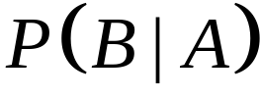
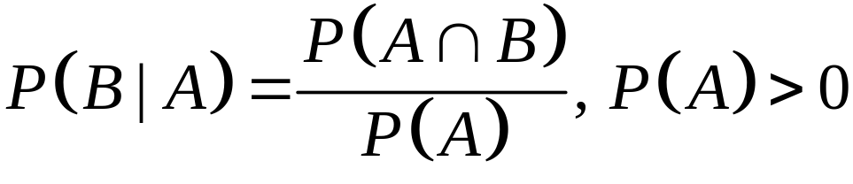
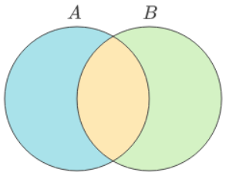
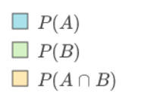
2.4 Conditional Probability
The conditional probability of an event B given event A, denote as is
Notes:
Flaw: vết rạn

Slide 44
2.4 Conditional Probability
Example 1:
In a certain town three newspapers are published. 20% of the
population read A, 16% read B, 14% read C, 8% read A and
B, 5% read A and C, 4% read B and C, and 2% read all 3
newspapers. A person is selected at random. Use a Venn
diagram to help determine the probability that the person
reads:
a/ A, given that the person reads at least one newspaper
b/ C, given that the person reads either A or B or both.
Notes:
a/ 4/7 ; b/ 1/4.

Slide 45
2.4 Conditional Probability
Example 2:
A box contains 4 red and 2 yellow tickets. Two tickets are random selected from the box one by one without replacement. Find the probability that:
a. Both are red
b. The first is red and the second is yellow.
Notes:
Flaw: vết rạn

Slide 46
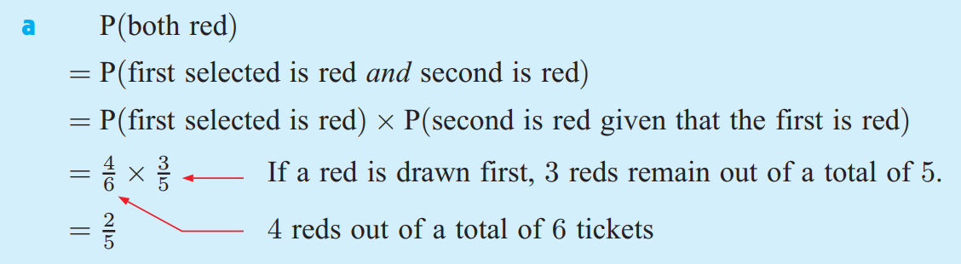
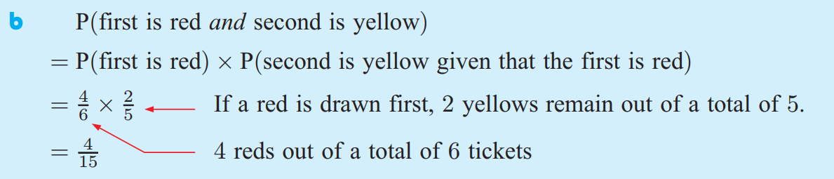
2.4 Conditional Probability
Solution
Notes:
Flaw: vết rạn

Slide 47
2.4 Conditional Probability
Example 3
A days production of 850 manufactured parts contains 50 parts that do not meet customer requirement. Two parts are selected randomly without replacement from the batch.
a/ What is the probability the the second part is defective given that the first part is defective ?
b/ If three parts are selected at random, what is the probability that the first two are defective and the third is not defective ?
Notes:
Flaw: vết rạn

Slide 48
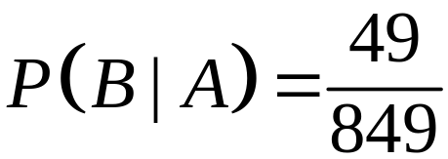

2.4 Conditional Probability
Solution
a/ Let A denote the event that the first part selected is defective, and let B denote the event that the second part selected is defective. The probability needed can be expressed as
b/ This event can be described in shorthand notation as simply P(ddn).
We have
Notes:
Flaw: vết rạn

Slide 49
2.4 Conditional Probability
Example 4:
Disks of polycarbonate plastic from a supplier are analyzed for scratch and shock resistance. The results from 100 disks summarized as follows:
Let A denote the
event that a disk
has high shock
resistance, and B
denote the
event that a disk has high scratch resistance. Determine the following probabilities:
a/ P(A) b/ P(B) c/ P(A|B) d/ P(B|A)
 |  | Shock resistance
 |  | high | low
Scratch resistance | High | 70 | 9
 | low | 16 | 5
Notes:
Flaw: vết rạn; Đĩa nhựa polycarbonate từ nhà cung cấp được phân tích về khả năng chống trầy xước và va đập. Kết quả từ 100 đĩa tóm tắt như sau:

Slide 50


2.4 Conditional Probability
Example 5
A lot contains 15 castings from a local supplier and 25
castings from a supplier in the next state. Two castings are
selected randomly, without replacement, from the lot of 40.
Let A be the event that the first casting selected is from the
local supplier, and let B denote the event that the second
casting is selected from the local supplier. Determine:
a/ P(A) b/ P(B|A)
c/ d/
Notes:
Lot: lô hàng, castings: các vật đúc, local supplier: nhà cung cấp địa phương, next state: bang bên cạnh. Lô chứa 15 vật đúc từ nhà cung cấp địa phương và 25 vật đúc từ một nhà cung cấp ở trạng thái tiếp theo. Hai vật đúc là được chọn ngẫu nhiên, không thay thế, từ lô 40. Gọi A là biến cố lần đúc đầu tiên được chọn từ nhà cung cấp địa phương, và gọi B là biến cố mà nhà cung cấp thứ hai đúc được chọn từ nhà cung cấp địa phương.

Slide 51


2.5 Multiplication Rules
2.5.1 Multiplication Rule
From conditional probability formula
or
We have

Slide 52
2.5 Multiplication Rules
Example:
The probability that the first stage of a numerically controlled machining operation for high-rpm pistons meet specifications is 0.9. Failures are due to metal variation, fixture alignment, cutting blade condition, vibration, and ambient environmental conditions. Given that the first stage mets specifications the probability that a second stage of matchining meets specifications is 0.95. What is the probability that both satges meet specification ?
Notes:
Stage: giai đoạn, machining: (sự) gia công, operation: các hoạt động, rpm: đơn vị đo số vòng quay của động cơ trong 1 phút. Xác suất để giai đoạn đầu tiên của hoạt động gia công được điều khiển bằng số đối với các pít-tông có vòng tua máy cao đáp ứng các thông số kỹ thuật là 0,9. Hỏng hóc là do sự thay đổi của kim loại, căn chỉnh cố định, tình trạng lưỡi cắt, độ rung và điều kiện môi trường xung quanh. Cho rằng giai đoạn đầu tiên đáp ứng các thông số kỹ thuật, xác suất mà giai đoạn khớp thứ hai đáp ứng các thông số kỹ thuật là 0,95. Xác suất mà cả hai satges đáp ứng đặc điểm kỹ thuật là gì ?

Slide 53

2.5 Multiplication Rules
Solution
Let A and B denote the events that first and seconds stages meet specification, respectively.The probability requested is
Why do you not use fomula ?
Notes:
Flaw: vết rạn

Slide 54



2.6 Independence
Definition (two events)
Two events are independent if any one of the following equivalent statements is true:
a/
b/
c/

Slide 55

2.6 Independence
Example 1 : Suppose a days production of 850 manufactured parts contains 50 parts that do no meet customer requirement. Suppose two parts are selected from the batch, but the first part is replaced before the second part is selected.
What is the probability that second part is defective given that the first part is defective ?
Solution
The probability that both parts are defective is
Notes:
Giả sử một ngày sản xuất 850 bộ phận được sản xuất có 50 bộ phận không đáp ứng yêu cầu của khách hàng. Giả sử hai phần được chọn từ lô, nhưng phần đầu tiên được thay thế trước khi phần thứ hai được chọn.

Slide 56



2.6 Independence
Example 1 : Suppose a days production of 850 manufactured parts contains 50 parts that do no meet customer requirement. Suppose two parts are selected from the batch, but the first part is replaced before the second part is selected.
What is the probability that second part is defective given that the first part is defective ?
Solution:
Let be event that the first part is defective.
Let be event that the second part is defective.
The probability that both parts are defective is
Notes:
Giả sử một ngày sản xuất 850 bộ phận được sản xuất có 50 bộ phận không đáp ứng yêu cầu của khách hàng. Giả sử hai phần được chọn từ lô, nhưng phần đầu tiên được thay thế trước khi phần thứ hai được chọn.

Slide 57

2.6 Independence
Example 2:
The following circuit operates only if there is path of functional devices from left to right. The probability that each device functions is shown on the graph. Assume that devise fail independently.
What is the probability that the circuit operates ?
Notes:
Circuit: (vật lý) mạch, operates: hoạt động, functional devices: các dụng cụ chức năng, Mạch sau chỉ hoạt động nếu có đường đi của các thiết bị chức năng từ trái sang phải. Xác suất mà mỗi thiết bị hoạt động được hiển thị trên biểu đồ. Giả sử rằng devise thất bại một cách độc lập. Xác suất mà mạch hoạt động là gì?

Slide 58


2.6 Independence
Example 2:
The following circuit operates only if there is path of functional devices from left to right. The probability that each device functions is shown on the graph. Assume that devise fail independently. What is the probability that the circuit operates ?
Solution:
Let and denote the events that the left and right devices operate, respectively. There is only a path if both operate. The probability the circuit operates is
Notes:
Circuit: (vật lý) mạch, operates: hoạt động, functional devices: các dụng cụ chức năng, Mạch sau chỉ hoạt động nếu có đường đi của các thiết bị chức năng từ trái sang phải. Xác suất mà mỗi thiết bị hoạt động được hiển thị trên biểu đồ. Giả sử rằng devise thất bại một cách độc lập. Xác suất mà mạch hoạt động là gì?

Slide 59

2.6 Independence
Example 3:
The following circuit operates only if there is a path of functional devices from left to right. The probability that each device funtions is shown on the graph. Assume that devices fail independently. What is the probability that the circuit operates ?

Slide 60




2.6 Independence
Solution:
Let T and B denote the events that the top and bottom
devices operate, respectively. There is a path if at least
one device operates. The probability that the circuit
operates is
A simple formula for the solution can be derived from
the complements and . From the independence
assumption,
So

Slide 61
2.6 Independence
Practical Interpretation:
Notice that the probability that the circuit operates is larger than the probability that either device is functional. This is an advantage of a parallel architecture. A disadvantage is that multiple devices are needed

Slide 62


2.6 Independence
Definition (multiple events)
The events are independent if and
only if for any subset of these events

Slide 63
2.6 Independence
Example 4:
An archer always hits a circular target with each arrow fired, and hits the bullseye on average 2 out of every 5 shots. If 3 arrows are fired at the target, determine the probability that the bullseye is hit:
a/ every time
b/ the first two times, but not on the third shot
c/ on no occasion.
Notes:
Archer: người bắn cung, hit: bắn trúng, target: bia, bullseye: trọng tâm, tâm; shot: phát bắn; arrow: mũi tên;

Slide 64

2.6 Independence
Solution
Let A be the event the first time the archer hits.
Let B be the event the second time the archer hits
Let C be the event the third time the archer hits
a/

Slide 65


2.6 Independence
Solution:
b/
c/

Slide 66

2.6 Independence
Example 5:
The following circuit operates only if there is a path of functional devices from left to right. The probability that each device functions is shown on the graph. Assume that
devices fail independently. What is the probability that the circuit operates ?

Slide 67



2.6 Independence
Solution: The solution can be obtained from a partition of the graph into three columns. Let L denote the event that there is a path of functional devices only through the three units on the left. From the independence and based upon the previous example,
Similarly, let M denote the event that there is a path of functional devices only through the two units in the middle. Then,
The probability that there is a path of functional devices only through the one unit on the right is simply the probability
that the device functions, namely, 0.99. Therefore, with the independence assumption used again, the solution is

Slide 68




2.6 Independence
Example 6:
Assume that the probability that a wafer contains a large particle of contamination is 0.01 and that the wafers are independent; that is, the probability that a wafer contains
a large particle does not depend on the characteristics of any of the other wafers. If 15 wafers are analyzed, what is the
probability that no large particles are found ?
Solution: Let denote the event that the ith wafer contains no large particles, . Then, . The probability requested can be represented as
From the independence assumption

Slide 69

2.6 Independence
Difference Between Mutually Exclusive and Independent Events
Notes:
Contamination: su lam bẩn

Slide 70
2.6 Independence
Difference Between Mutually Exclusive and Independent Events.
BASIS FOR COMPARISON | MUTUALLY EXCLUSIVE EVENTS | INDEPENDENT EVENTS
Meaning | Two events are said to be mutually exclusive, when their occurrence is not simultaneous. | Two events are said to be independent, when the occurrence of one event cannot control the occurrence of other.
Influence | Occurrence of one event will result in the non-occurrence of the other. | Occurrence of one event will have no influence on the occurrence of the other.
Mathematical formula | P(A and B) = 0 | P(A and B) = P(A) P(B)
Sets in Venn diagram | Does not overlap | Overlaps
Notes:
Influence: ảnh hưởng, Occurrence: tần suất xảy ra.

Slide 71


2.7 Multiplication and Total Probability Rules
2.7.1 Total Probability Rule (two events)
Partitioning an event into two mutually exclusive subsets.
For any events and ,

Slide 72
2.7 Multiplication and Total Probability Rules
2.7.1 Total Probability Rule (two events)
Example 1:A can contains 4 blue and 2 green marbles. One
marble is randomly drawn from the can without
replacement and its colour is noted. A second marble is
then drawn.
Find the probability that the second marble is blue ?
Notes:
Contamination: su lam bẩn

Slide 73


2.7 Multiplication and Total Probability Rules
2.7.1 Total Probability Rule (two events)
Solution
Let A be the event that the first marble is green.
Let B be the event that the second marble is blue.
Notes:
Flaw: vết rạn

Slide 74
2.7 Multiplication and Total Probability Rules
2.7.1 Total Probability Rule (two events)
Example 2
Suppose that in semiconductor manufacturing the probability is 0.10 that a chip that is subjected to high levels of contamination during manufacturing causes a product failure. The probability is 0.005 that a chip that is not subjected to high contamination levels during manufacturing causes a product failure. In a particular production run, 20% of the chip are subject to high levels of contamination.
What is the probability that a product using one of these chips fails?
Notes:
Giả sử rằng trong sản xuất chất bán dẫn, xác suất là 0,10 rằng một con chip bị nhiễm bẩn ở mức độ cao trong quá trình sản xuất sẽ gây ra lỗi sản phẩm. Xác suất là 0,005 rằng một con chip không bị nhiễm bẩn ở mức độ cao trong quá trình sản xuất gây ra lỗi sản phẩm. Trong một lần sản xuất cụ thể, 20% chip có thể bị nhiễm bẩn ở mức độ cao. Xác suất mà một sản phẩm sử dụng một trong những con chip này bị lỗi là bao nhiêu?

Slide 75


2.7 Multiplication and Total Probability Rules
2.7.1 Total Probability Rule (two events)
Solution
Let denote the event that the product fails, and let H denote the event that the chip is exposed to high levels of contamination.
The requested probability is
Then

Slide 76


2.7 Multiplication and Total Probability Rules
2.7.2 Total Probability Rule (multiple events)
Assume are mutually exclusive and
exhaustive sets. Then
Partitioning an event into several mutually exclusive subsets.

Slide 77
2.7 Multiplication and Total Probability Rules
2.7.2 Total Probability Rule (multiple events)
Example 3:
A newspaper printer has three presses A, B, and C which print 30%, 40%, and 30% of daily production respectively. Due to the age of the machines and other problems, the presses will produce streaks on their output 3%, 5%, and 7% of the time, respectively.
Find the probability that a randomly chosen newspaper does not have streaks ?
Notes:
Contamination: su lam bẩn; Một máy in báo có ba máy in A, B và C lần lượt in 30%, 40% và 30% sản lượng hàng ngày. Do tuổi đời của máy móc và các vấn đề khác, máy ép sẽ tạo ra các vệt trên đầu ra lần lượt là 3%, 5% và 7% thời gian. Tìm xác suất để một tờ báo được chọn ngẫu nhiên không có sọc?

Slide 78



2.8 Bayes’ Theorem
Definition

Slide 79
2.8 Bayes’ Theorem
Example 1
A can contains 4 blue and 2 green marbles. One marble is randomly draw from the can without replacement and its colour is noted. A second marble is the drawn. Find the probability that:
a/ The second marble is blue.
b/ The first was green given that the second marble is blue.
Notes:
Flaw: vết rạn

Slide 80



2.8 Bayes’ Theorem
Solution
Let A be the events that first marble is green.
Let B be the events that first marble is blue.
a/
Notes:
Flaw: vết rạn

Slide 81


2.8 Bayes’ Theorem
Solution
b/
Notes:
Flaw: vết rạn

Slide 82
2.8 Bayes’ Theorem
Example 2
54% of the students at a university are female. 8% of the male students are colour-blind and 2% of the female students are colour-blind.
a/ A randomly chosen student is colour-blind. Find the probability that the student is male.
b/ A randomly chosen student is not colour-blind. Find the probability that the student is female.
Notes:
Contamination: su lam bẩn

Slide 83

2.8 Bayes’ Theorem
Solution
Let be the events that the student is male
Let chosen student is colour-blind.
a/
The probability that the student is male
Notes:
Flaw: vết rạn

Slide 84




2.8 Bayes’ Theorem
Solution
Let be the events that the student is female
Let chosen student is not colour-blind.
b/
The probability that the student is female
Notes:
Flaw: vết rạn

Slide 85
2.8 Bayes’ Theorem
Example 3
A man drives his car to work 80% of the time. The remainder of the time he rides his bicycle. When he rides his bicycle to work he is late 25% of the time, whereas when he drives his car to work he is late 15% of the time. On a particular day, the man arrives early. Find the probability that he rode his bicycle to work that day.
Notes:
Contamination: su lam bẩn

Slide 86
2.8 Bayes’ Theorem
Example 4
A new blood test has been designed to detect a form of cancer. The probability that the test correctly identifies someone with the cancer is 0.97, and the probability that the test correctly identifies someone without the cancer is 0.93. Approximately 0.1% of the general population are known to contract this cancer. When a patient has a blood test, the test results are positive for the cancer.
Find the probability that the patient actually has the cancer ?
Notes:
Một xét nghiệm máu mới đã được thiết kế để phát hiện một dạng ung thư. Xác suất xét nghiệm xác định chính xác một người mắc bệnh ung thư là 0,97 và xác suất xét nghiệm xác định chính xác một người không mắc bệnh ung thư là 0,93. Khoảng 0,1% dân số nói chung được biết là mắc bệnh ung thư này. Khi bệnh nhân xét nghiệm máu, kết quả xét nghiệm là dương tính với ung thư. Tìm xác suất bệnh nhân đó thực sự bị ung thư?

Slide 87


2.8 Bayes’ Theorem
General
Assume are mutually exclusive and
exhaustive sets. Then
for

Slide 88
Example 5:
Bayesian networks are used on the Web sites of hight – technology manufactures to allow customers to quickly diagnose problems with products. An oversimplified example is presented here. A printer manufacturer obtained the following probabilities from a database of test results. Printer failures are associated with three types of problems: hardware, software and other (such as connectors), with probabilities 0.1, 0.6, and 0.3, respectively. The probability of a printer failure given a hardware problem is 0.9, given software problem is 0.2 and given any other type of problem is 0.5. If a customer enters the manufacturer’s Web site to diagnose, what is the most likely cause of the problem?
Notes:
Diagnose: chuẩn đoán

Slide 89


Solution:
Let the events H, S and O denote a hardware, software and other problem, respectively and let F denote a printer failure. The most likely cause of the problem is the one that corresponds to the largest of P(H/F), P(S|F) and P(O|F). In Bayes’Theorem the denominatior is
Then

Slide 90

Similarly,

Slide 91
An inspector working for a manufacturing company has a 99% chance of correctly identifying defective items and a 0.5% chance of incorrectly classifying a good item as defective. The company has evidence that its line produces 0.9% of nonconforming items.
a/ What is the probability that an item selected for inspection is classified as defective?
b/ If an item selected at random is classified as non-defective, what is the probability that it is indeed good ?

